Slide 1

OPEN REDIRECT SCANNER
By:-
Mahankali koushik
2003A53010

Slide 2
ABSTRACT :-
Open redirect is a security defect in an app or a web page that causes it to fail to properly authenticate URLs. When apps and web pages have requests for URLs, they are supposed to prove that those URLs are part of the expected page’s domain. To test the web-based application manually for Open Redirection is very difficult. So we need an automated script that can make the task of manual testing easier and save the time of the penetration tester. OpenRedireX is an automated script developed in the Python language which tests the single URL and Multiple URLs or Open Redirection Vulnerability by inserting the payload of open redirection into the URL parameter and analyzing the response from the server. OpenRedireX supports customizing the payload list and also allows users to use their payload list. OpenRedireX tool is open-source and free to use. These can be done in linux , kali finder tools in the linux operating system.

Slide 3
INTRODUCTION :-
The “ Open Redirect Scanner ” is a vulnerability that can be used to manipulate the application to redirect the users to a different URL other can be the one that’s intended , this can be done by manipulating the URL to include the parameters that redirects the user to different URL’s . Open Redirect Scanner is a problem if the same redirect doesn’t features filtered or validated then it becomes unsafe as there is a possibility of an attacker inserting malicious content into the input ensures the high amount of risk into it .

Slide 4
Open Redirect Scanner uses the various types of methods to prevent into it they are :-
HTTP Location Header :- It specifies the new browser location , is the most common redirection method
Eg :- Location : https://www.attacker.com/
Meta tag redirects :- it uses the HTML meta tag to navigate the new locations .
Eg :- <meta http-equiv = “refresh” content = “0:url=https://www.attacker.com/” />
DOM – based redirects the use JavaScript to manipulate the DOM window properties .
Eg :- window.location = ‘https://www.attacker .com’

Slide 5
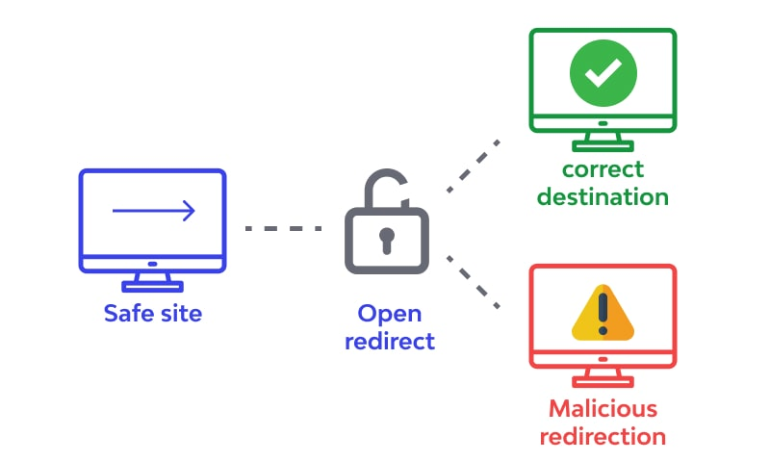
Architecture :-
Open Redirect Scanner / vulnerabilities arises the application incorporates the controllable data into targets the redirection of an unsafe way . An attacker can create a URL within the application that causes the redirection to an arbitrary external domain . these process can be done while the data seen as :-
When safe site URL has entered the login(username, passwords) credentials the open redirect navigates into the correct destination or malicious redirection says into it .
When data sends the data by open redirect into the correct navigation site .

Slide 6
SURVEY :-
This article was published by “Uber.com by InfoSec Write -ups” says about the unvalidated redirects & forwards are possible when a web application
that domain redirects the URL
that sends the evil URL with a payload(that obfuscate the url for cheat the user with any encode that available)
code executes their part of execution to follow requests the final destination & sees that if open redirect scanner works or not .
scanner loads a list of subdomains an add a payload to final url sees what it does .

Slide 7
EXISTING SYSTEM:-
The existing system of websites and applications is a complex networks of connection between internet , URL’s, interconnected technologies & services allowed by the users to access and interact with digital content and services on the internet . some key components are existing system that includes are :-
Use fast scan to find open redirect vulnerabilities : that they used the vulnerabilities that writes the url to scan and click stat button to proceed the process into it . but it ha some limitations Into it are:-
If we want to scan parameters of form used the page of HTML form parser
To get fast scan allows the parameter in query using HTTP GET method
Use expert mode if application accepts the data using HTTP methods are:
> POST
> PUT
> DELETE
If application requires the authentication from web access page should be scan uses the expert mode from authentication mode into it.

Slide 8
b) HTML from parser are to scan web page from parameters that has many forms to submit then data to server by means of login , contact , search forms into it. The URL enters into the HTML format parser area uses analyze button to popup the select form to scan into it. Some hints are:-
Use authentication header if web page needs authentications
We can set HTTP methods & use any valid header as we want
Request body can be set with any HTTP methods
c) Uses the expert mode are ability to alter the aspect of HTTP request that includes the choosing of HTTP methods are:-
-> GET
->POST
->PUT
-> DELETE
Selecting the HTTP headers , as well as deciding the request body into it.

Slide 9
PROPOSED SYSTEM:-
Different kinds of Open Redirects are:-
Header based:- Header-based is a location header sent from the server. The benefit with this, from an attacker's perspective, is that the redirect always works even if JavaScript is not interpreted. A server-side function that gets a URL as input will follow the redirect and end up somewhere else.
JavaScript based:- When the redirect instead happens in Javascript it only works in scenarios where Javascript is executed. It might not work for server-side functions, but it will work in the victim's web browser.

Slide 10
If the redirect happens in Javascript it might also be possible to cause a redirect to javascript: something(), which would be an XSS in itself.
Our main motive is to find the website is having any malicious content that having any access of the main in the middle attack that can captures the data into it.

Slide 11
SUMMARIZE :-
While using these methodology we can easily find the occurs of the web page is being redirected the another URL in another domain via a user – controlled input , an attacker can use this vulnerabilities to redirect the users to other malicious websites, which can be used for phishing attack and similar attacks into it . DOM based arises the when a script writes controllable data into the targeted of a redirection in an unsafe manner.

Slide 12
ADVANTAGES :-
Improves the website security by implementing these type of security parameters that measures the improvement of security of website or web application that reduces the risk of unauthorized access or data theft into it.
Project has the high efficiency that any developer can access and performs the security parameters for better experiences of their ensuring the data and personal data / information are secure into it.
They especially dangerous the because an attacker knows the were trying of the specific websites , which makes the vulnerabilities to a phishing attack .

Slide 13
DISADVANTAGES
That vulnerabilities website security measures the significances of the improve security of web application or website that reduces the risk of unauthorized access or data theft.
Maintenance and updates that web application requires the ongoing maintenance and updates the remain secure and functional of time consuming and especially for large or complex systems.
Compatibility issues that websites and web applications must be compatible with various browsers, search engines , operating systems and devices which can compatibility issues and there requirements for additional developments and requirements and testing efforts .

Slide 14
TOOLS / ALGORITHMS USED :-
Oralyzer : is the tool used for the web based application for CRLF injection flaw that tool is fully automated tool is a fully automated tool developed in the python language it supports the proxy , custom payload use and extracting URL’s from Wayback machine.
DOM : DOM based the open redirection arises when a script writes the controllable data into the target of a redirection in an unsafe way . An attacker may able to uses the vulnerabilities to construct URL that visited by another application user, will cause redirection to arbitrary external domain.
Append >> : uses the operator adds the output to existing content instead of overwriting the allows the redirect the output from multiple commands to a signal file.

Slide 15
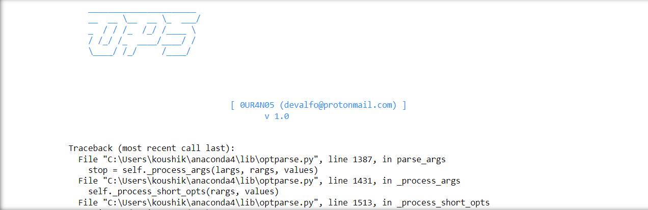
RESULTs:-

Slide 16
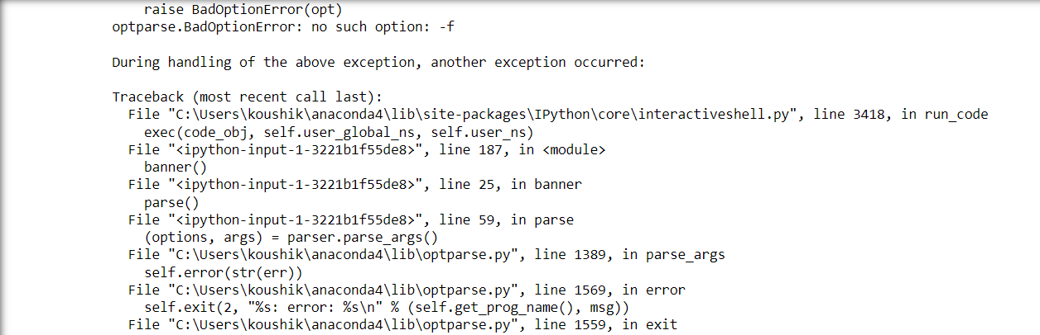

Slide 17
CONCLUSION:-
We now know how harmful an open redirect vulnerability can be and why it is so important to prevent it. The easiest and the most effective way to prevent it is by not letting your user have control of where the page redirects them to. It is only necessary to provide users with the authority to enter short keywords and map them to the target URL or simply allow them to confirm before being redirected to the destination.

Slide 18
REFERENCES:-
https://learn.snyk.io/lessons/open-redirect/javascript/
https://brightsec.com/blog/open-redirect-vulnerabilities/
https://secnhack.in/open-redirection-vulnerability exploiting-and-mitigation

Slide 19
Thank you

